Slide 1
C6: Evaluating LLMs

Slide 2
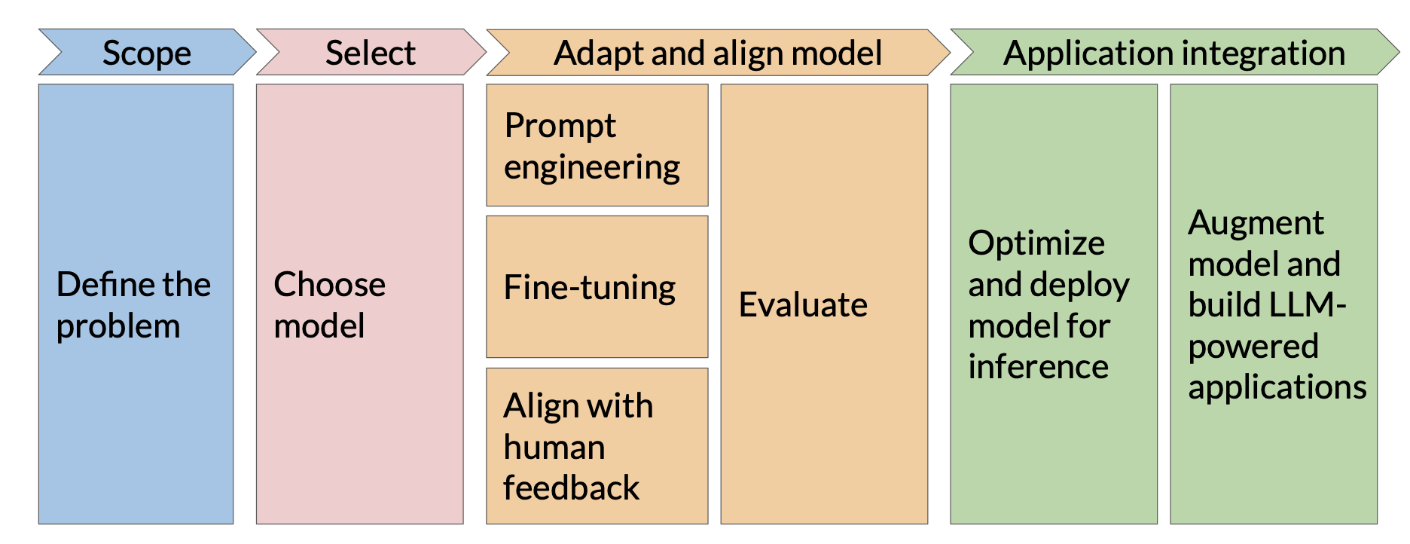
Prompt engineering

Slide 3
Challenges
“Mike really loves drinking tea.”
=
“Mike adores sipping tea.”
Recognizing paraphrases that use entirely different vocabulary or structure.
“Mike does not drink coffee.”
<>
“Mike does drink coffee.”
Understanding negation, sarcasm, or modality, where a single token alters intent.

Slide 4
Classic LLM metrics
ROUGE
BLEU
Used for text summarization
Compares a summary to one
or more reference summaries
Used for text translation
Compares to human-generated
translations

Slide 5


Classic LLM metrics
N-gram
Mike really loves drinking tea and eating Italian pasta.
unigram
2-gram

Slide 6
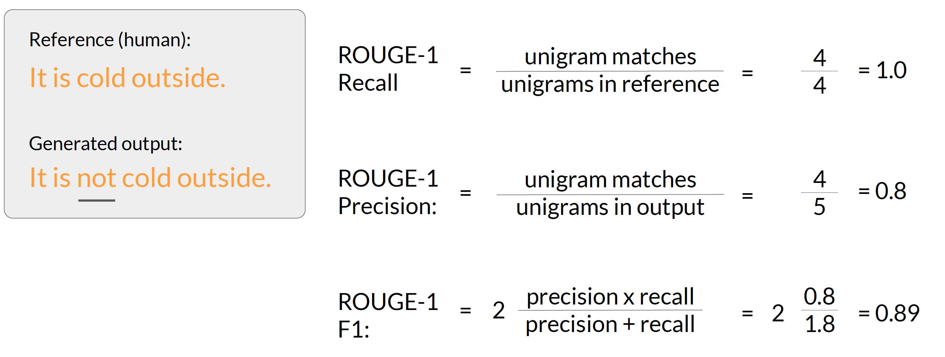
Rouge-1

Slide 7
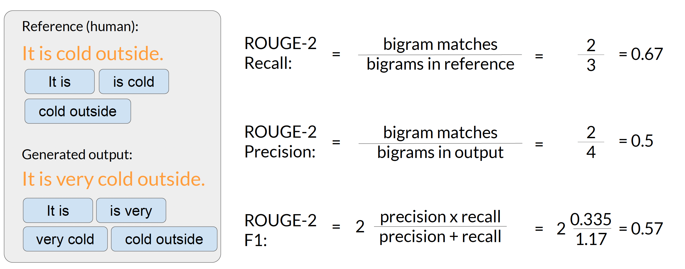
Rouge-2

Slide 8
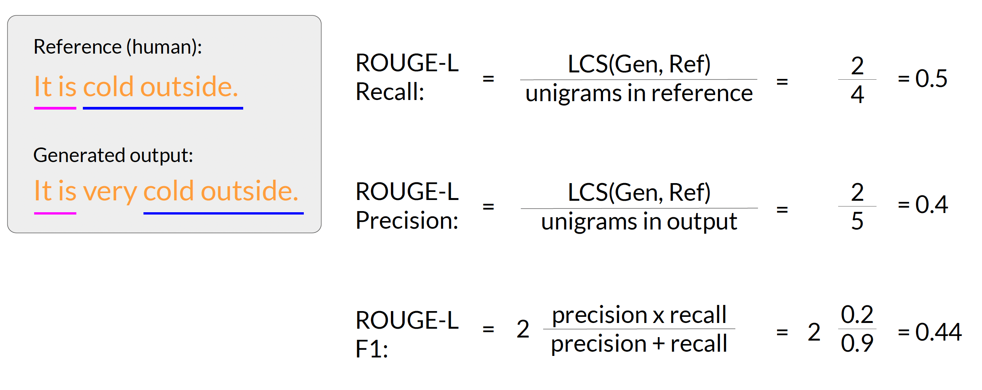
ROUGE-l
LCS:
Longest common subsequence

Slide 9
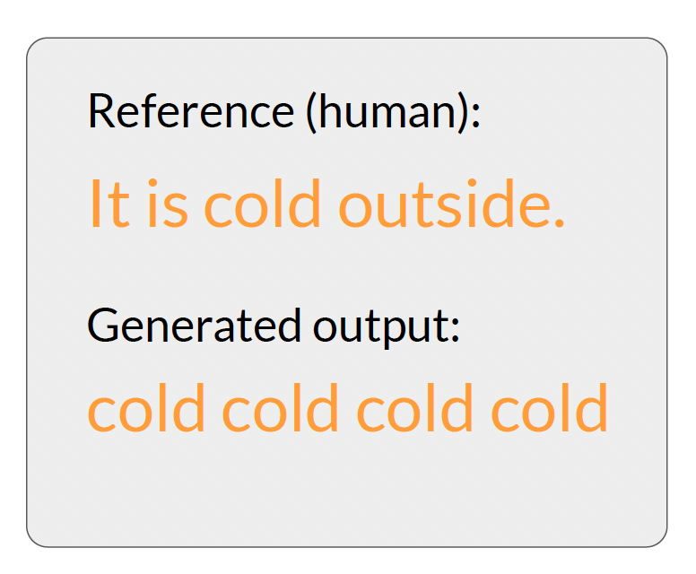
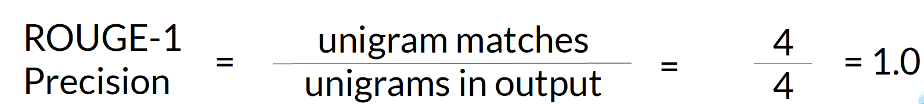
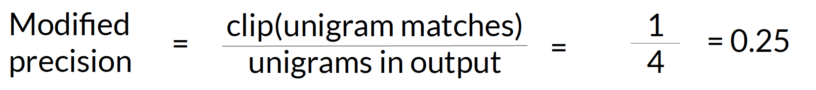
Hacking Rouge
Solution?
What about ? cold outside it is ?

Slide 10
Bleu
BLEU metric = Avg(precision across range of n-gram sizes)
BLEU assumes the candidate is judged against the reference — so it measures how much of the candidate is correct.
vs
Rouge that it checks how much of the reference appears in the candidate.
She enjoys reading a fascinating science fiction novel.
1. She loves reading an interesting science fiction book. — BLEU: 0.621
2. She enjoys reading a thrilling science fiction novel. — BLEU: 0.782
3. She enjoys reading a fascinating science fiction novel. — BLEU: 1.000
Avg(unigram precision + 2-gram precision .. 4-gram precision)

Slide 11
Human evaluation
Human judgment remains the gold standard for assessing LLM outputs, especially for subjective or complex tasks.
• Qualitative Insights: Human evaluators can assess nuances like cultural context, ethical considerations, and user experience, which are challenging for automated systems.
• Evaluation Criteria: Common aspects assessed by humans include fluency, coherence, relevance, and factual correctness.
• Challenges: Human evaluation is resource-intensive, time-consuming, and may introduce variability due to subjective interpretations.

Slide 12
Human evaluation
Solutions to bias problem:
standardized evaluation rubrics
multiple annotators per sample

Slide 13

Benchmarks

Slide 14
Benchmarks
GLUE (General Language Understanding Evaluation)
A benchmark to evaluate how well models understand natural language across a set of core tasks (Sentiment classification, Textual entailment, Question answering etc.)
Test general language understanding across multiple domains.
SuperGLUE
A harder version of GLUE, meant to challenge more advanced models (Causal reasoning, Coreference resolution, Multi-sentence reading comprehension etc.)
Push the limits of reasoning, inference, and common sense.

Slide 15
Benchmarks
MMLU (Massive Multitask Language Understanding)
A benchmark testing expert-level knowledge across 57 diverse subjects (Math, Law, Medicine etc.)
Evaluate models on factual knowledge and reasoning in academic and professional fields.
BIG-Bench (Beyond the Imitation Game Benchmark)
A collaborative benchmark with 200+ tasks, crowdsourced from researchers globally (Logical reasoning, Wordplay, Code writing etc.)
Test emergent abilities and broad generalization in LLMs.

Slide 16
Benchmarks
MMLU (Massive Multitask Language Understanding)
A benchmark testing expert-level knowledge across 57 diverse subjects (Math, Law, Medicine etc.)
Evaluate models on factual knowledge and reasoning in academic and professional fields.
BIG-Bench (Beyond the Imitation Game Benchmark)
A collaborative benchmark with 200+ tasks, crowdsourced from researchers globally (Logical reasoning, Wordplay, Code writing etc.)
Test emergent abilities and broad generalization in LLMs.

Slide 17
LLM-judge
LLM-as-a-Judge refers to using a LLM to evaluate the outputs of other LLMs — instead of relying entirely on humans.
Description
Why It Matters
Helpfulness | Does the output clearly and usefully answer the prompt? | Central to user experience
Relevance | Is the response focused on the question or topic? | Reduces fluff or off-topic rambling
Factuality | Are the claims accurate and grounded in truth? | Crucial for trust and safety
Coherence | Is the answer logically structured and internally consistent? | Avoids contradictions and confusion
Fluency | Is the language smooth, grammatical, and readable? | Impacts user readability and trust
Conciseness | Is the response succinct, without unnecessary repetition? | Helps with UX in production systems

Slide 18
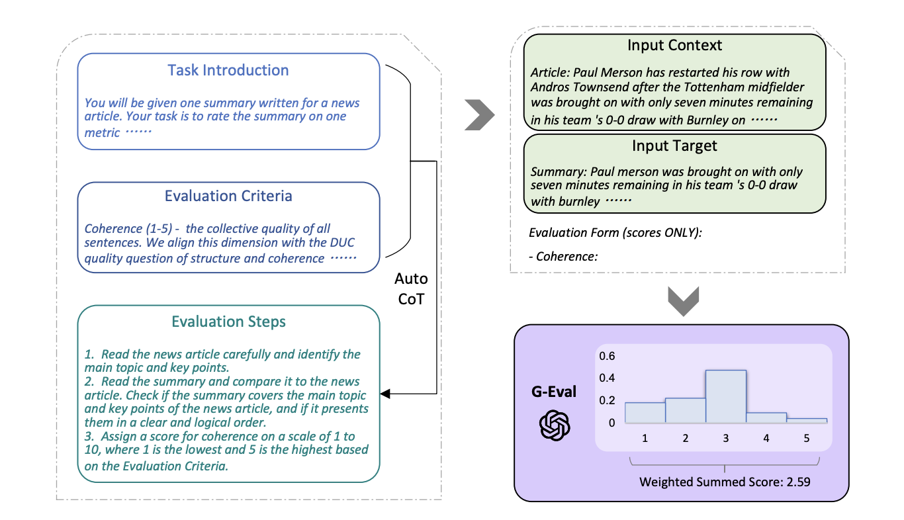
LLM-judge – Geval
Article

Slide 19
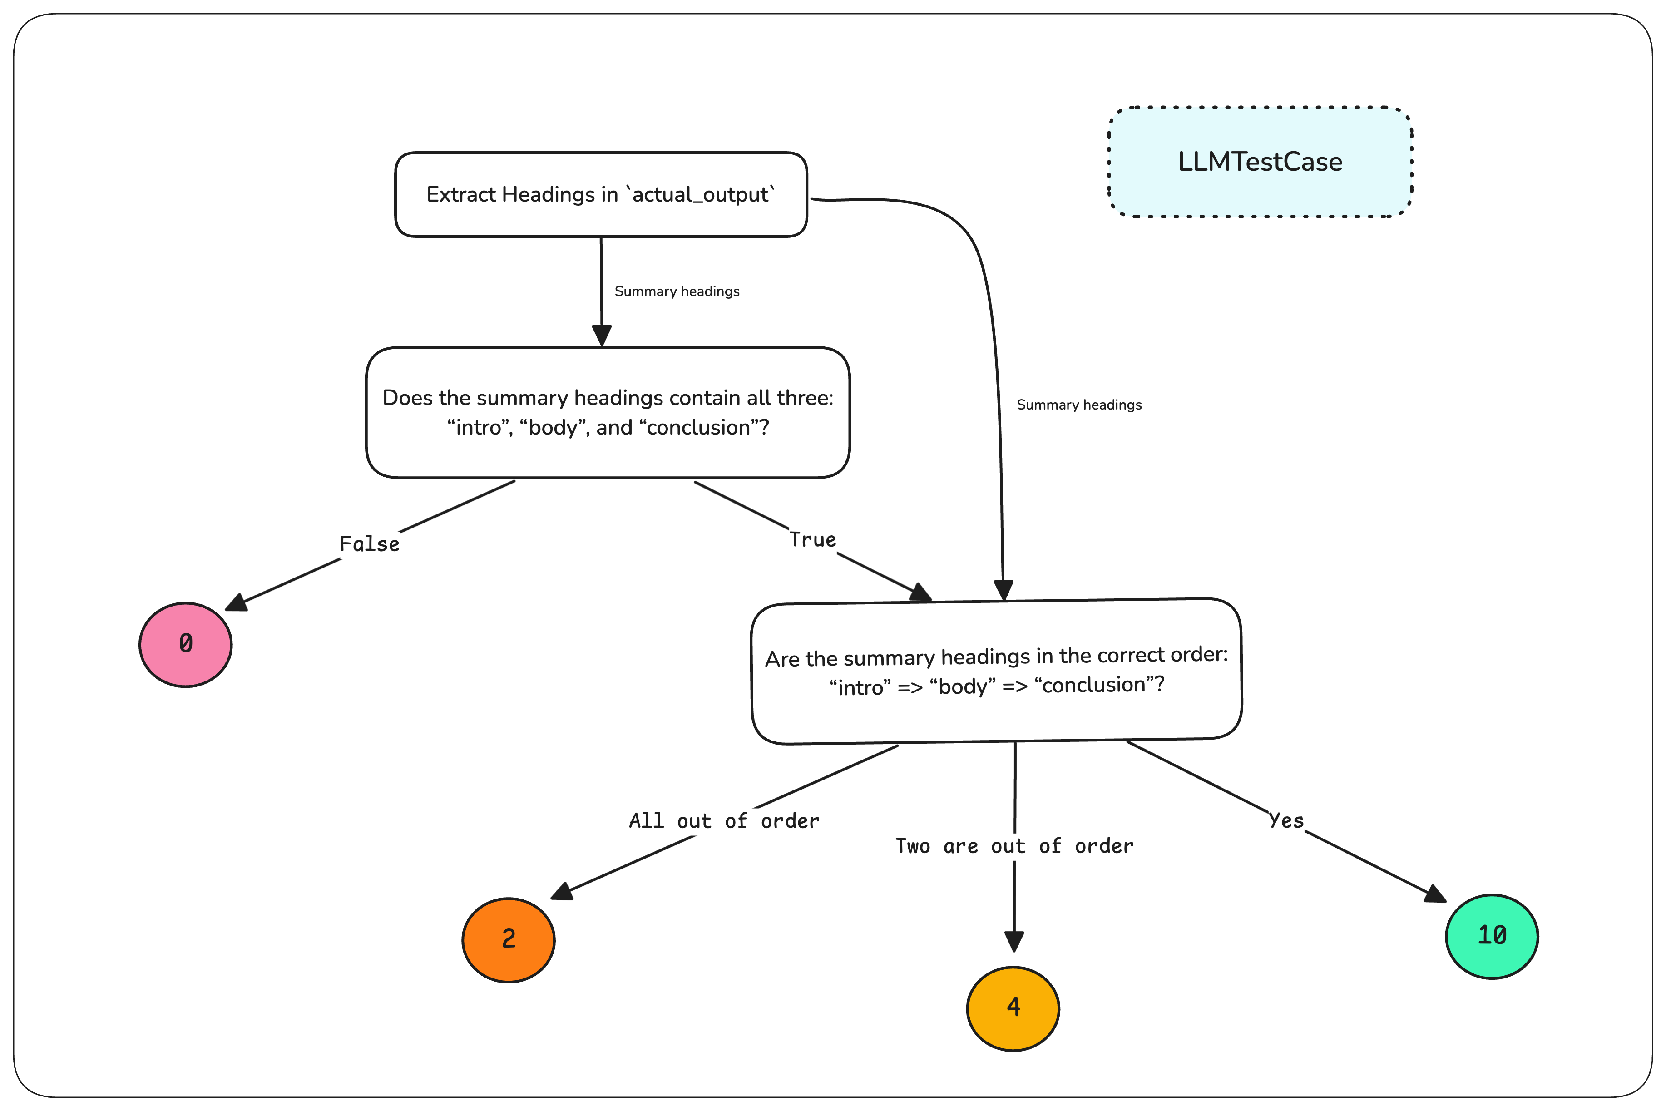
LLM-judge – DAG
Article

